Slide 1

CSE2PM09A / AID2PM07A
Design and Analysis of Algorithm
DEPARTMENT OF COMPUTER SCIENCE AND ENGINEERING

Slide 2
Algorithm Design Techniques/Strategies
Brute force
Divide and conquer
Space and time tradeoffs
Greedy approach
Dynamic programming
Backtracking
Branch and bound

Slide 3
Unit 2: Divide and Conquer
Introduction
Principle control abstraction
Quick Sort
Merge sort
Large Integer multiplication/ Strassen matrix multiplication

Slide 4
Divide & Conquer
Control Abstraction
DANDC (P)
{
  if SMALL (P) then return S (p);
  else
  {
    divide p into smaller instances p1, p2, …. Pk, k >= 1;
    apply DANDC to each of these sub problems;
    return (COMBINE (DANDC (p1) , DANDC (p2),…., DANDC (pk));
  }
}
Divide the problem into smaller sub problems
Conquer the sub problems by solving them recursively.
Combine the solutions to the sub problems into the solution of the original problem.
Notes:
sahani

Slide 5
Divide-and-Conquer Technique (cont.)
a problem of size n
(instance)
subproblem 1
of size n/2
subproblem 2
of size n/2
a solution to
subproblem 1
a solution to
subproblem 2
a solution to
the original problem
It general leads to a recursive algorithm!
Notes:
A levitin

Slide 6

Time complexity of the general algorithm
A Recurrence is an equation or inequality that describes a function in terms of its value on smaller inputs
Special techniques are required to analyze the space and time required
Time complexity (recurrence relation):
where D(n) : time for splitting
C(n) : time for conquer
c : a constant

Slide 7
Divide-and-Conquer Examples
Sorting : Mergesort and Quicksort
Binary tree traversals
Binary search
Multiplication of large integers
Matrix multiplication: Strassen’s algorithm
Closest-pair and convex-hull algorithms
Notes:
A levitin

Slide 8
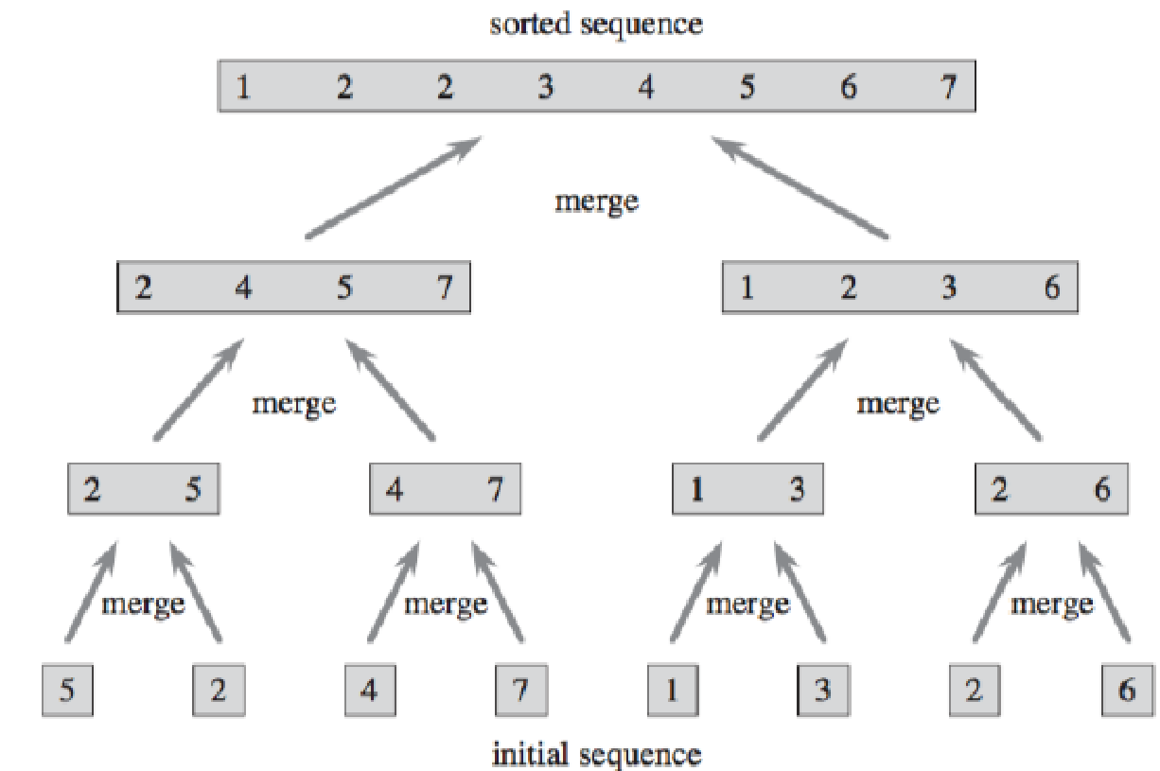
Mergesort
Merge sort is a divide and conquer algorithm for sorting arrays. To sort an array, first you split it into two arrays of roughly equal size. Then sort each of those arrays using merge sort, and merge the two sorted arrays.

Slide 9

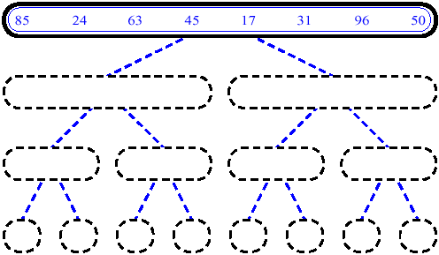
MergeSort (Example) - 1

Slide 10
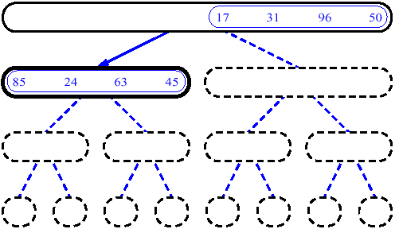
MergeSort (Example) - 2

Slide 11
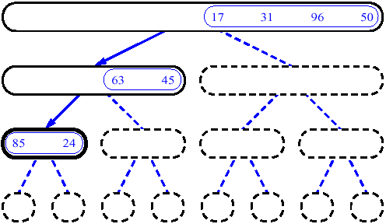
MergeSort (Example) - 3

Slide 12
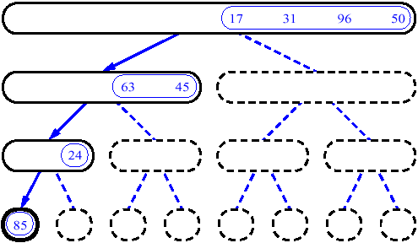
MergeSort (Example) - 4

Slide 13
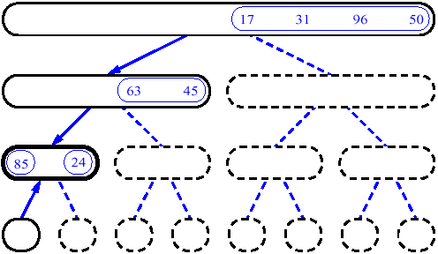
MergeSort (Example) - 5

Slide 14
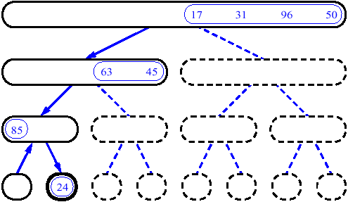
MergeSort (Example) - 6

Slide 15
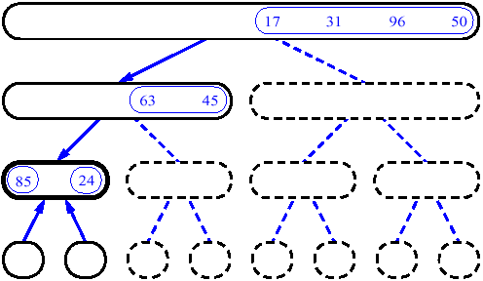
MergeSort (Example) - 7

Slide 16
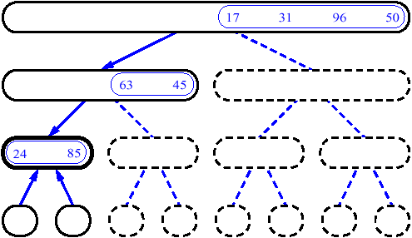
MergeSort (Example) - 8

Slide 17
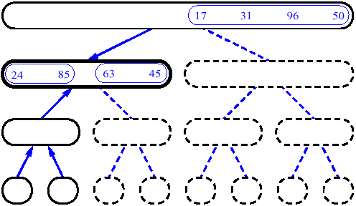
MergeSort (Example) - 9

Slide 18
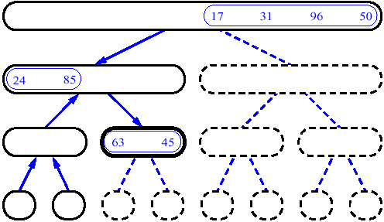
MergeSort (Example) - 10

Slide 19
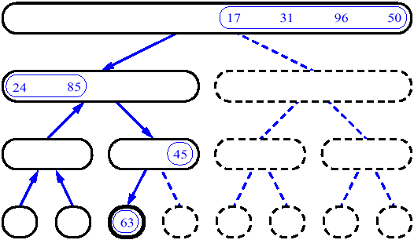
MergeSort (Example) - 11

Slide 20
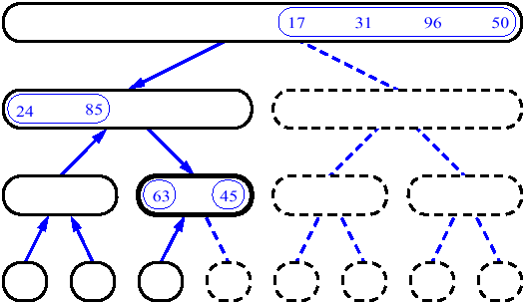
MergeSort (Example) - 12

Slide 21
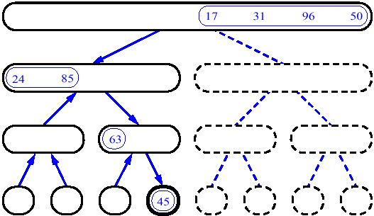
MergeSort (Example) - 13

Slide 22
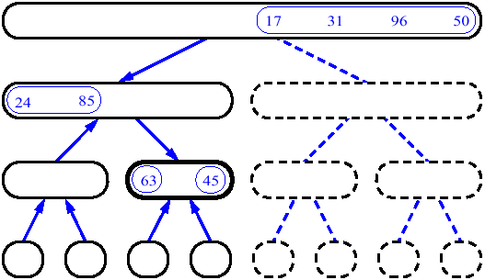
MergeSort (Example) - 14

Slide 23
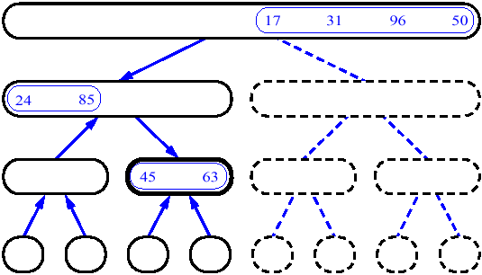
MergeSort (Example) - 15

Slide 24
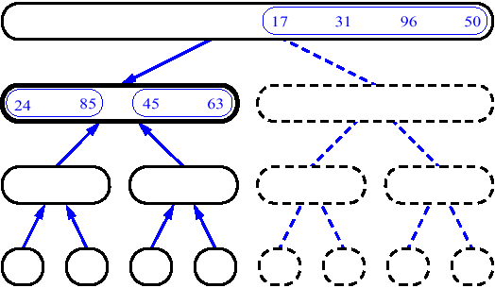
MergeSort (Example) - 16

Slide 25
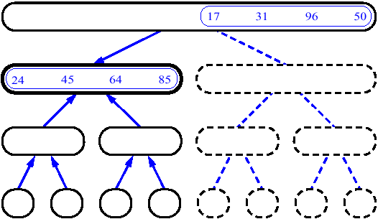
MergeSort (Example) - 17

Slide 26
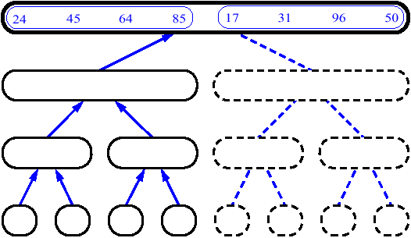
MergeSort (Example) - 18

Slide 27
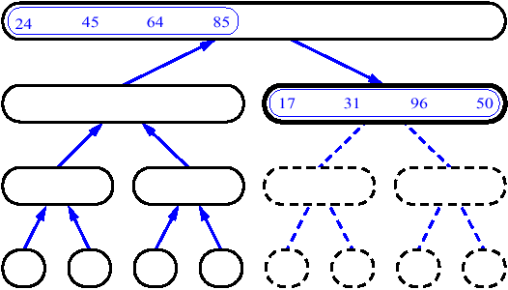
MergeSort (Example) - 19

Slide 28
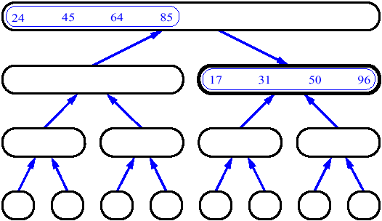
MergeSort (Example) - 20

Slide 29
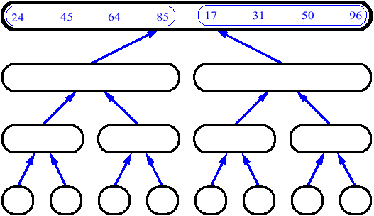
MergeSort (Example) - 21

Slide 30
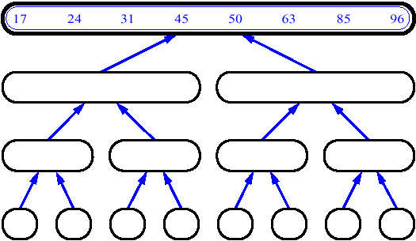
MergeSort (Example) - 22

Slide 31
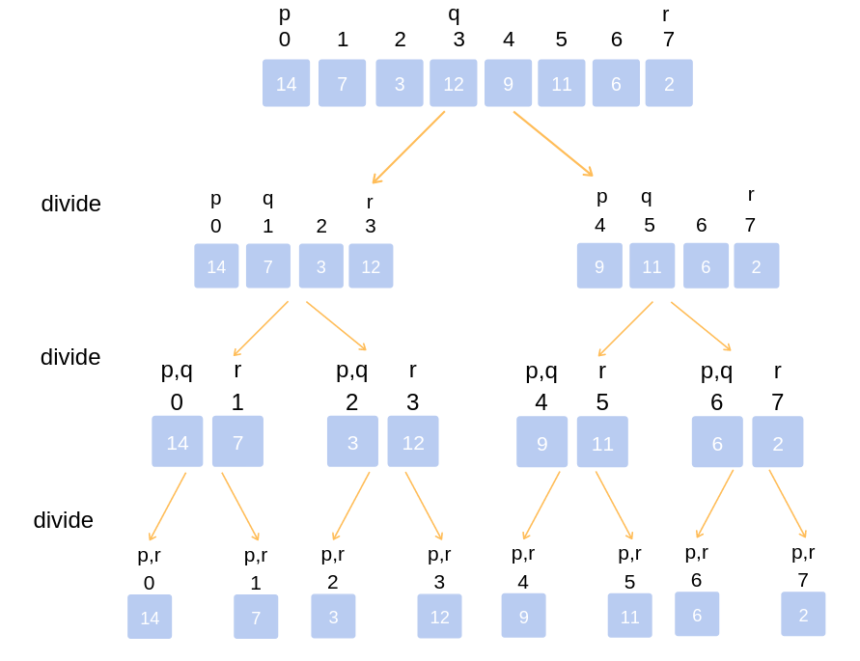
Merge Sort Algorithm
REF BOOK: Horowitz, Salmi & Rajasekaran
Algorithm MergeSort(a,low, high)
{
//a[low : high] array to be sorted
// Small(P) is true if there is only one element to sort. In this case the list is already sorted
if (low < high) // If there are more than one element
{
// Divide P into subproblems. Find where to split the set.
mid := | (low + high)/2|;
// Solve the subproblems.
MergeSort(a,low, mid);
MergeSort(a,mid + 1, high);
// Combine the solutions.
Merge(a,low, mid, high);
}
}

Slide 32
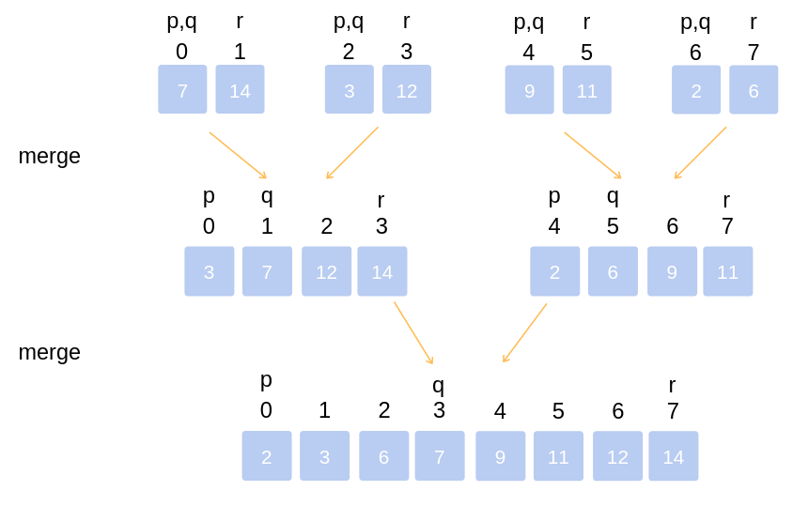
Algorithm Merge(a,low, mid , high)
// a[low : high] is array containing two sorted
/ / subsets in a[ low; : mid] and in a[mid + 1 : high] .
The go is to merge these two sets into a single set residing
// in a[low : high] . b[ ] is an auxiliary global array.
{
h := low ; i := low ; j := mid + 1;
while ( ( h <= mid) and (j <= high)) do
{
if ( a[ h] <= a[j])
{
b[i] := a[h] ;h := h + 1;
}
else
{
b[i ] := a[j ] ; j:= j+ l ;
}
i:= i + 1;
}
if ( h > mid) then
for k := j to high do
{
b[i] := a[ k] ; i:= i + 1;
}
else
for k := h to mid do
{
b[i] := a[ k] ; i:= i+ 1 ;
}
for k := low to high do a[ k] := b[ k] ;
}
REF BOOK: Horowitz, Salmi & Rajasekaran

Slide 33
Pseudocode of Merge-Sort (A, p, r)
INPUT: a sequence of n numbers stored in array A
OUTPUT: an ordered sequence of n numbers
MergeSort (A, p, r) // sort A[p..r] by divide & conquer
if p < r
then q ← ⎣(p+r)/2⎦
MergeSort (A, p, q)
MergeSort (A, q+1, r)
Merge (A, p, q, r) // merges A[p..q] with A[q+1..r]
Initial Call: MergeSort(A, 1, n)

Slide 34
Procedure Merge
  Merge(A, p, q, r)
  1 n₁ ← q – p + 1
  2 n₂ ← r – q
  for i ← 1 to n₁
  do L[i] ← A[p + i – 1]
  for j ← 1 to n₂
  do R[j] ← A[q + j]
  L[n₁+1] ← ∞
  R[n₂+1] ← ∞
  i ← 1
  j ← 1
  for k ←p to r
  do if L[i] ≤ R[j]
  then A[k] ← L[i]
  i ← i + 1
  else A[k] ← R[j]
  j ← j + 1
Input: Array containing sorted subarrays A[p..q] and A[q+1..r].
Output: Merged sorted subarray in A[p..r].
Sentinels, to avoid having to
check if either subarray is
fully copied at each step.

Slide 35
Analysis of Mergesort
Running time T(n) of Merge Sort:
Divide: computing the middle takes Θ(1)
Conquer: solving 2 sub problems takes 2T(n/2)
Combine: merging n elements takes Θ(n)
Total:
    T(n) = Θ(1) if n = 1
    T(n) = 2T(n/2) + Θ(n) if n > 1
  T(n) = Θ(n lg n)
  Space requirement: Θ(n) (not in-place)
Notes:
even if not analyzing in detail, show the recurrence for mergesort in worst case:
T(n) = 2 T(n/2) + (n-1)
worst case comparisons for merge

Slide 36
Recursion Tree for Merge Sort
Ref Book: Thomas Cormen
For the original problem, we have a cost of cn, plus two sub problems each of size (n/2) and running time T(n/2).
Each of the size n/2 problems has a cost of cn/2 plus two sub problems, each costing T(n/4).
cn
cn
Cost of divide and merge.
cn/2
cn/2
T(n/2)
T(n/2)
T(n/4)
T(n/4)
T(n/4)
T(n/4)
Cost of sorting subproblems.

Slide 37
Recursion Tree for Merge Sort
Ref Book: Thomas Cormen
Continue expanding until the problem size reduces to 1.
cn
cn
cn/2
cn/2
cn
lg n
cn/4
cn/4
cn/4
cn/4
cn
c
c
c
c
c
c
cn
Total : cnlgn+cn

Slide 38
Recursion Tree for Merge Sort
Ref Book: Thomas Cormen
Continue expanding until the problem size reduces to 1.
cn
Each level has total cost cn.
Each time we go down one level, the number of subproblems doubles, but the cost per subproblem halves ⇒ cost per level remains the same.
There are lg n + 1 levels, height is lg n. (Assuming n is a power of 2.)
  Can be proved by induction.
Total cost = sum of costs at each level = (lg n + 1)cn = cnlgn + cn = Θ(n lgn).
cn/2
cn/2
cn/4
cn/4
cn/4
cn/4
c
c
c
c
c
c

Slide 39
Quicksort
Ref Book: Thomas Cormen
Divide :
  Pick any element (pivot) v in array A[p…r]
  Partition array A into two groups
  A1[p - - -q-1] , A2 [q+1----r] Compute the index q
  A1 element < A[q] < A2 element
Conquer step: recursively sort A1 and A2
Combine step: the sorted A1 (by the time returned from recursion), followed by A[q], followed by the sorted A2 (i.e., nothing extra needs to be done)
v
A
v
A1
A2

Slide 40
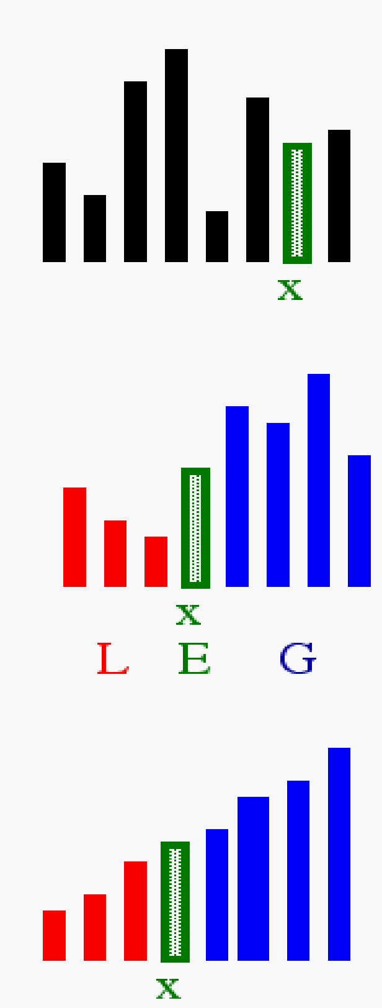
Idea of Quick Sort
Ref Book: Internet
1) Select: pick an element
2) Divide: rearrange elements so that x goes to its final position E
3) Recurse and Conquer: recursively sort

Slide 41
Quicksort Pseudo-code
INPUT: a sequence of n numbers stored in array A
OUTPUT: an ordered sequence of n numbers
QuickSort (A, p, r) // sort A[p..r] by divide & conquer
if p < r
then q = Partition (A, p, r)
QuickSort (A, p, q-1)
QuickSort (A, q+1, r)
Initial Call: QuickSort(A, 1, n)

Slide 42
Procedure Partitioning the array
Input: Array containing sorted subarrays A[p..q] and A[q+1..r].
Output: sorted subarray in A[p..r].
  Partition(A, p, r)
  1 x = A[r]
  2 i = p - 1
  for j ← p to r-1
  if A[j] ≤ x
  i= i +1
  exchange A[i] with A[j]
  exchange A[i+1] with A[j]
  Return i + 1

Slide 43
Apply quick sort for the following numbers:
2, 8, 7, 1, 3, 5, 6, 4

Slide 44
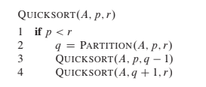
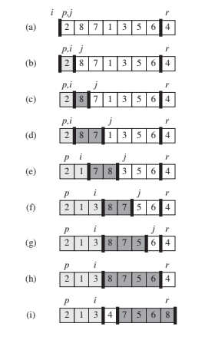
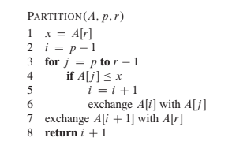

Slide 45
The steps of QuickSort
S
select pivot value
81
43
31
57
13
75
92
0
65
26
S₁
S₂
partition S
0
31
75
13
43
65
92
81
26
57
S₁
S₂
QuickSort(S₁) and
QuickSort(S₂)
0
13
26
31
43
57
65
75
81
92
S
0
13
26
31
43
57
65
75
81
92
Voila! S is sorted

Slide 46
Quicksort Analysis
Assumptions:
  A random pivot (no median-of-three partitioning)
  No cutoff for small arrays
Running time
  pivot selection: constant time, i.e. O(1)
  partitioning: linear time, i.e. O(N)
  running time of the two recursive calls
T(N)=T(i)+T(N-i-1)+cN where c is a constant
  i: number of elements in S1

Slide 47
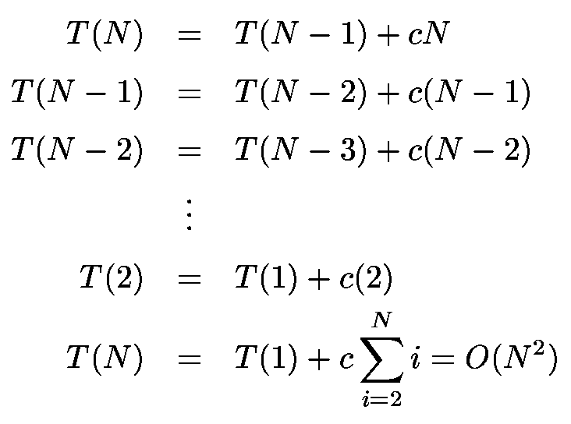
Worst-Case Analysis
worst case Partition?
  The pivot is the smallest element, all the time
  Partition is always unbalanced

Slide 48
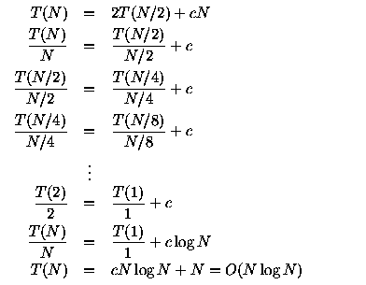
Best-case Analysis
best case Partitioning?
  Partition is perfectly balanced.
  Pivot is always in the middle (median of the array)

Slide 49
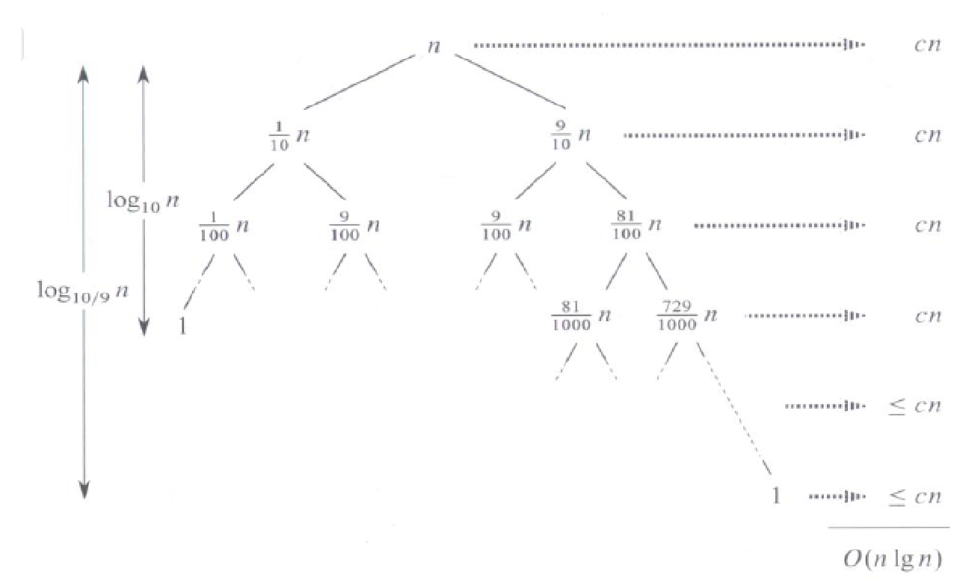
Average-Case Analysis
Intution for Average Case : We can get an idea of average case by considering the case when partition puts O(n/9) elements in one set and O(9n/10) elements in other set.
Following is recurrence for this case.
T(n) = T(n/9) + T(9n/10) + ϴ(n)
Solution of above recurrence is also O(nlogn)

Slide 50
Summary Analysis of Quicksort
Best case: split in the middle — Θ(n log n)
Worst case: sorted array! — Θ(n²)
Average case: random arrays — Θ(n log n)
Improvements:
  better pivot selection: median of three partitioning
  switch to insertion sort on small subfiles

Slide 51
Multiplication of Large Integers
Consider the problem of multiplying two (large) n-digit integers represented by arrays of their digits such as:
A = 12345678901357986429 B = 87654321284820912836
The grade-school algorithm:
a₁ a₂ … a_{n}
b₁ b₂ … b_{n}
(d₁₀) d₁₁d₁₂ … d_{1n}
(d₂₀) d₂₁d₂₂ … d_{2n}
… … … … … … …
(d_{n0}) d_{n1}d_{n2} … d_{nn}
Efficiency: Θ(n²) single-digit multiplications

Slide 52
First Divide-and-Conquer Algorithm
A small example: A * B where A = 2135 and B = 4014
A = (21·10² + 35), B = (40 ·10² + 14)
So, A * B = (21 ·10² + 35) * (40 ·10² + 14)
= 21 * 40 ·10⁴ + (21 * 14 + 35 * 40) ·10² + 35 * 14
In general, if A = A₁A₂ and B = B₁B₂ (where A and B are n-digit,
A₁, A₂, B₁, B₂ are n/2-digit numbers),
A * B = A₁ * B₁·10^{n} + (A₁ * B₂ + A₂ * B₁) ·10^{n/2} + A₂ * B₂
Recurrence for the number of one-digit multiplications M(n):
M(n) = 4M(n/2), M(1) = 1
Solution: M(n) = n²

Slide 53
Second Divide-and-Conquer Algorithm
A * B = A₁ * B₁·10^{n} + (A₁ * B₂ + A₂ * B₁) ·10^{n/2} + A₂ * B₂
The idea is to decrease the number of multiplications from 4 to 3:
(A₁ + A₂ ) * (B₁ + B₂ ) = A₁ * B₁ + (A₁ * B₂ + A₂ * B₁) + A₂ * B_{2,}
I.e., (A₁ * B₂ + A₂ * B₁) = (A₁ + A₂ ) * (B₁ + B₂ ) - A₁ * B₁ - A₂ * B_{2,}
which requires only 3 multiplications at the expense of (4-1) extra add/sub.
Recurrence for the number of multiplications M(n):
M(n) = 3M(n/2), M(1) = 1
Solution: M(n) = 3^{log 2n} = n^{log 23} ≈ n^{1.585}
What if we count both multiplications and additions?

Slide 54
Example of Large-Integer Multiplication
2135 * 4014
= (21*10^2 + 35) * (40*10^2 + 14)
= (21*40)*10^4 + c1*10^2 + 35*14
where c1 = (21+35)*(40+14) - 21*40 - 35*14, and
21*40 = (2*10 + 1) * (4*10 + 0)
= (2*4)*10^2 + c2*10 + 1*0
where c2 = (2+1)*(4+0) - 2*4 - 1*0, etc.
This process requires 9 digit multiplications as opposed to 16.

Slide 55
References
Thomas H Cormen and Charles E.L Leiserson, "Introduction to Algorithm" PHI Third Edition
Horowitz and Sahani, "Fundamentals of Computer Algorithms", 2ND Edition. University Press, ISBN: 978 81 7371 6126, 81 7371 61262.

